Slide 1

Swire Commodity Forecasting
Kurtis Castellanos

Slide 2
Business Problem
Swire needs Commodities to produce product.
Purchasing at optimal times increase profit margins.
Better inventory Management control

Slide 3
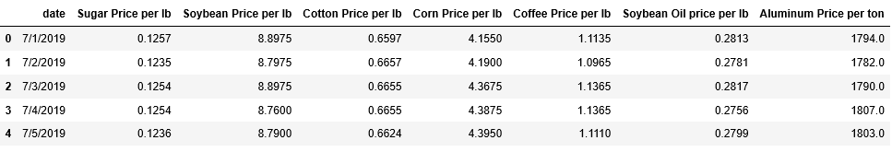
EDA
Data acquired through market watch
Data range for covid
Modifications made

Slide 4
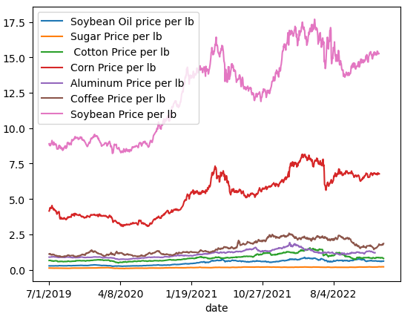
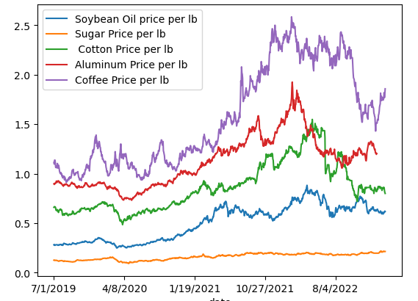
EDA Cont.
All Commodities Price over time
Soybean and Corn removed

Slide 5
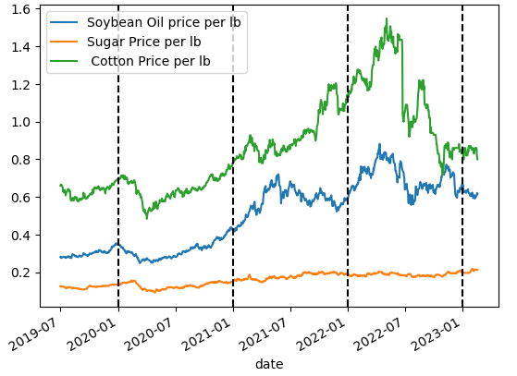
Seasonality
Important to check for seasonality trends
Can influence optimal purchase time
Data exhibited no seasonality

Slide 6
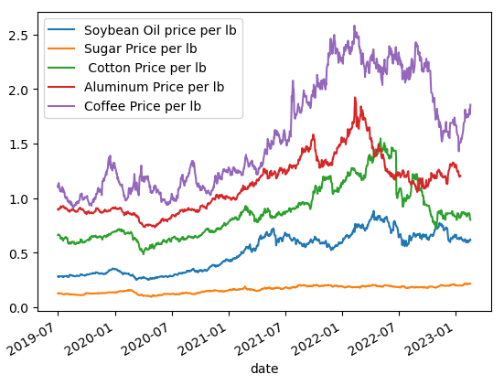
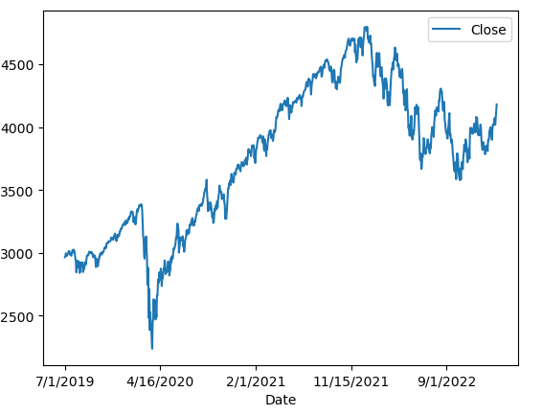
Economic Trends
Health of the General Economy can be used
S&P 500 index used as marker
Covid Impact

Slide 7
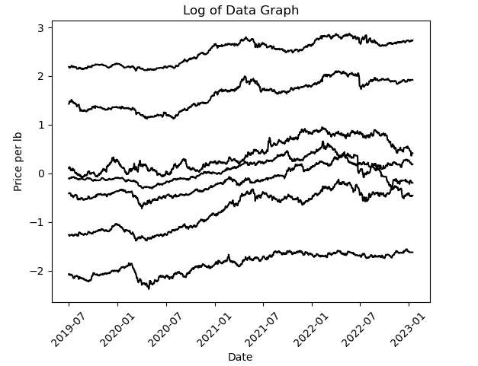
Modeling
Dickey-Fuller Test
Stationary Data
Log Transformation

Slide 8
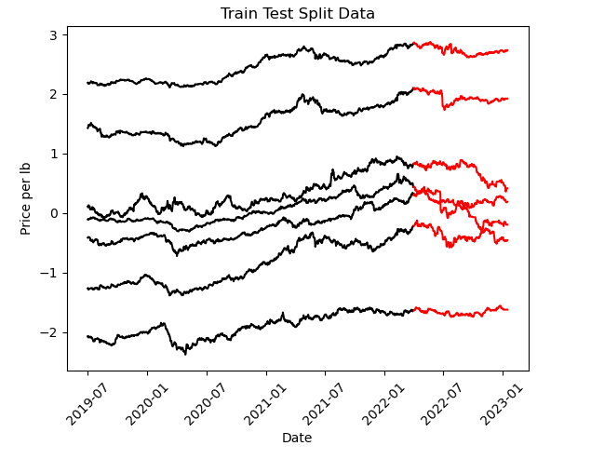
Modeling Cont.
Test Training Split
Overfit Data and impact
Accuracy Measures

Slide 9
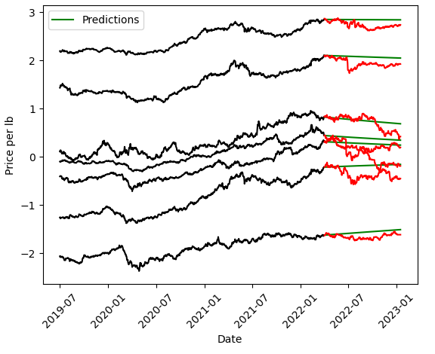
Model Selection
Autoregressive Moving Average Model
Cross Validation
Hyper Parameters

Slide 10
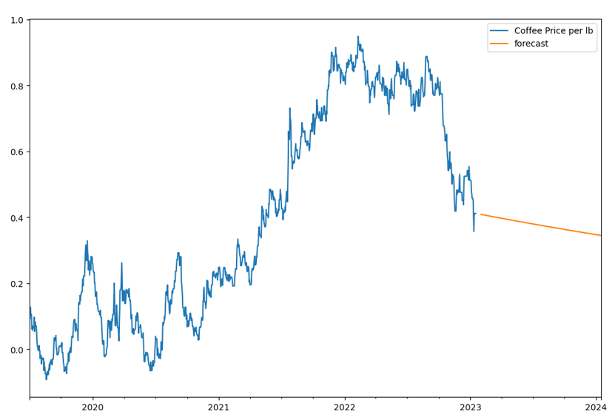
Results and Future Direction
Length of time Limited
Combine with other known predictors
For optimal results
Efficacy test
Date | Coffee Price
9-15-2023 | 1.65
10-15-2023 | 1.59
11-15-2023 | 1.47
12-15-2023 | 1.45
1-15-2024 | 1.41

Slide 11
Summary
Avg RMSE score:.134
Exponentiate Results for accurate prices
Combine Model Predictions with observable economic trends

